Slide 1

Predictive dynamical models for intermittent contact
Sam Burden
Assistant Professor
Electrical Engineering
University of Washington
Seattle, WA USA
http://faculty.uw.edu/sburden
AMP Lab
http://depts.washington.edu/amplify
BioRobotics Lab
http://brl.ee.washington.edu

Slide 2
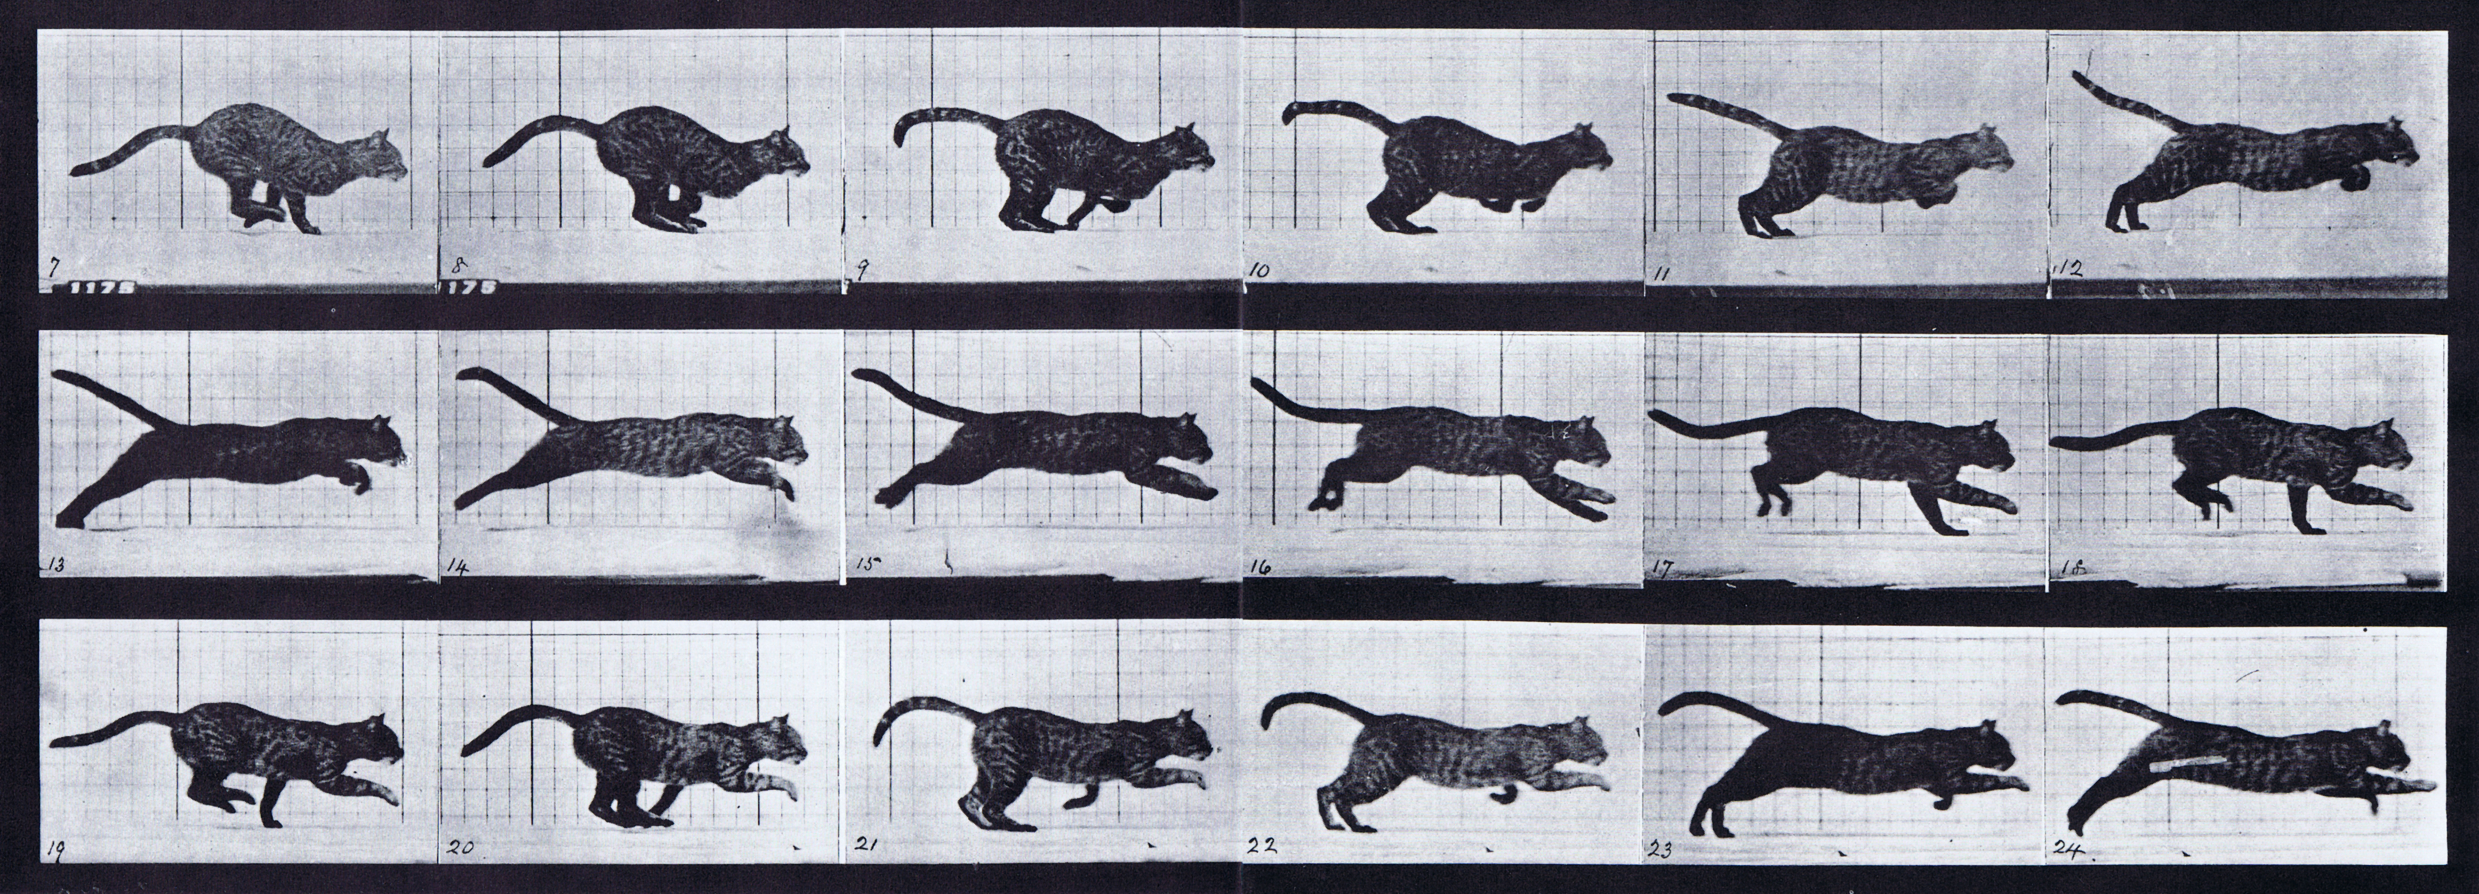


simple models for locomotion and
manipulation are piecewise-defined
Muybridge 1887 (reprinted by Dover in 1957)
limbs in contact with ground
ground penetration constraints
continuous dynamics
impact dynamics
Theorem (Ballard):
trajectories exist uniquely for all forward time
Johnson, Burden, Koditschek IJRR 2016
A hybrid systems model for simple
manipulation and self-manipulation systems
Ballard Archive Rat. Mech. Anal. 2000
Dynamics of Discrete Mechanical Systems with Perfect Unilateral Constraints

Slide 3


Slide 4
Theorem (Aizerman & Gantmacher et al):
when contact mode sequence is given,
final state varies differentiably w.r.t. initial state
Aizerman & Gantmacher 1958
Quarterly Journal of Mechanics and Applied Mathematics
Determination of Stability by Linear Approximation of a Periodic Solution of a System of Differential Equations with Discontinuous Right-Hand Sides
Grizzle, Abba, Plestan IEEE TAC 2002
Di Bernardo, Budd, Kowalczyk, Champneys Springer 2008
Burden, Revzen, Sastry IEEE TAC 2015

Slide 5
Theorem (Remy et al):
for simultaneous impacts, final state generally
varies discontinuously w.r.t. initial state
Hürmüzlü and Marghitu
International Journal of Robotics Research 1994
Rigid Body Collisions of Planar Kinematic Chains With Multiple Contact Points
Remy, Buffington, Siegwart
International Journal of Robotics Research 2010
Stability Analysis of Passive Dynamic Walking of Quadrupeds

Slide 6



Theorem (Pace, Burden):
if constraints are orthogonal (in body frame),
final state varies differentiably* w.r.t. initial state
* technically piecewise-differentiably; for details, read:
Pace, Burden (arXiv:1610.05645)
Piecewise-differentiable trajectory outcomes in mechanical systems subject to unilateral constraints
Burden, Sastry, Koditschek, Revzen SIADS 2016 (arXiv:1407.1775)
Event-Selected Vector Field Discontinuities Yield Piecewise-Differentiable Flows

Slide 7
challenges for predictive dynamical modeling of intermittent contact
1. pathologies in simple predictive models
— should we change our models or our robots?
2. data-driven predictive models
— (how) should we derive models directly from data?

Slide 8
when limbs are rigid, final state generally
varies discontinuously with respect to initial conditions when contact mode sequence varies
— scalable (gradient-based) algorithms for learning or control cannot change contact mode sequence

Slide 9
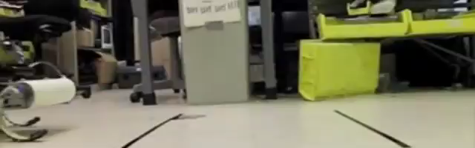

do we observe discontinuous outcomes?
Galloway, Haynes, Ilhan, Johnson, Knopf, Lynch, Plotnick, White, Koditschek UPenn 2010
Hyun, Seok, Lee, Kim IJRR 2014

Slide 10
when limbs are compliant, final state varies differentiably with respect to initial conditions
when contact mode sequence varies
— scalable (gradient-based) algorithms for learning or control can change contact mode sequence

Slide 11
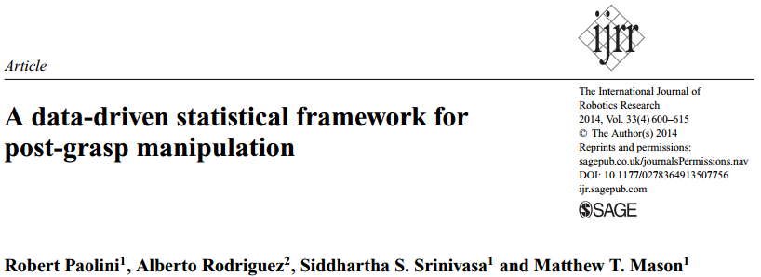
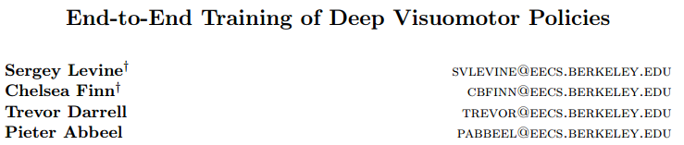
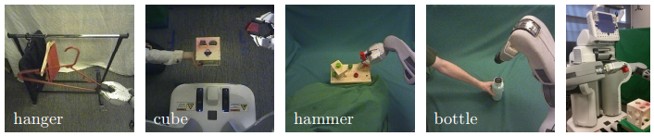
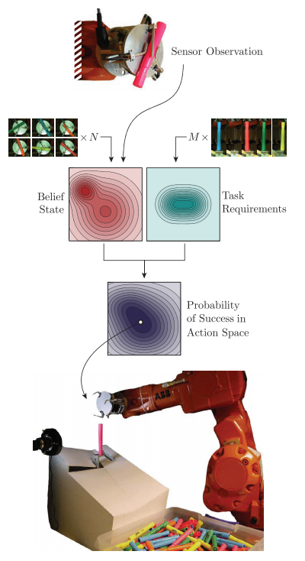
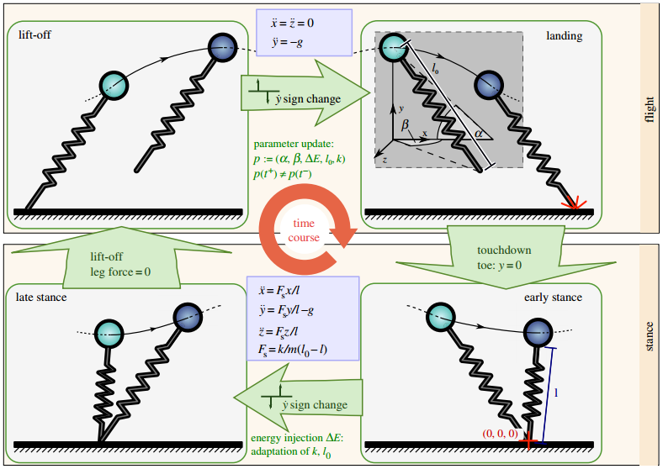
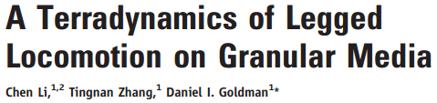
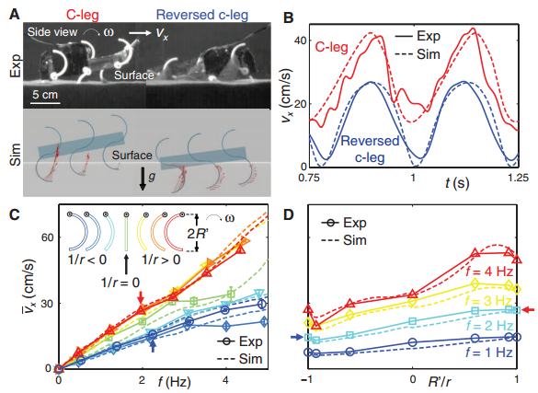
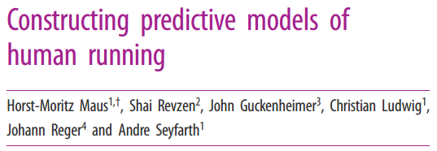

Slide 12






thank you!
collaborators
sburden@uw.edu
http://faculty.uw.edu/sburden
Shankar Sastry
Shai Revzen
Aaron Johnson
Dan Koditschek
Andrew Pace
ARO YIP #W911NF-16-1-0158: Predictive models for sensorimotor control of legged locomotion

